Slide 1
Medical Incapacitation – in Flight:
Private: Pleasure and Business.
Evidence based – risk.
Consistent – fair – NZ way.
Competency vs privilege.
Harmony – Internationally.

Slide 2
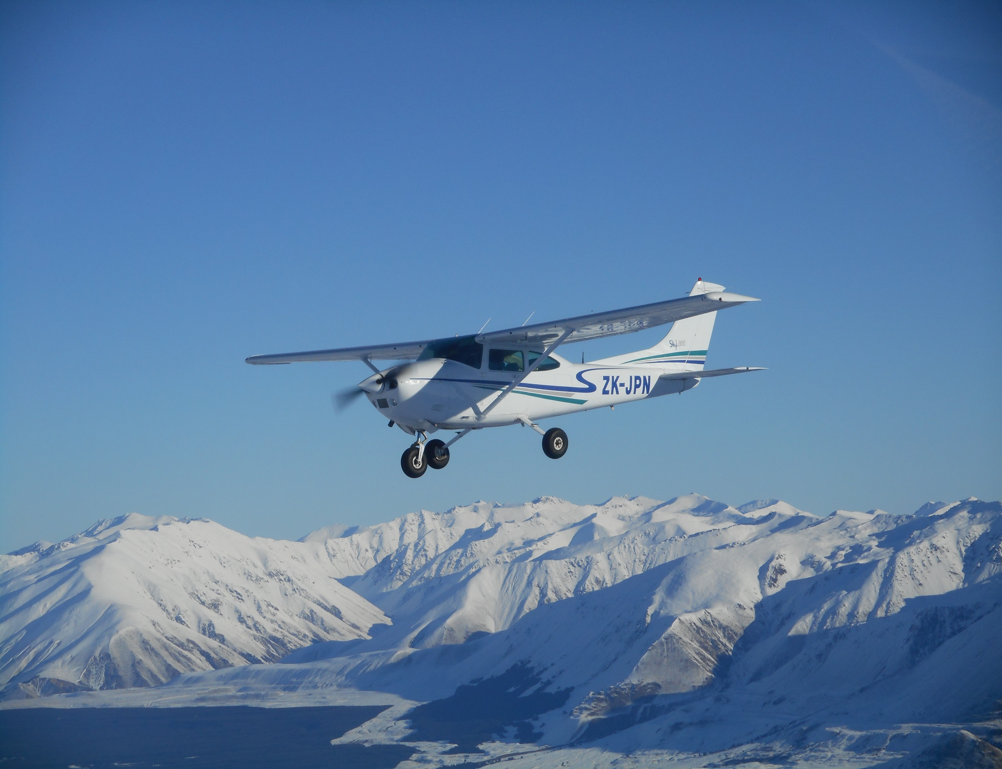

Slide 3
Medical Incapacitation – New Zealand:
Private: Pleasure and Business.
Very low level in compliant pilots.
Recreational Pilot’s – no medical fatalities.

Slide 4
Risk:
Lloyds Coffee shop – the origin of risk management.
Commercial 1,000,000,000 passenger miles per fatality.
Private: Pleasure and Business – never quantified.
Average RPL fly 30 hours a year – bus driver 2,400 hours pa.
Regulators need to regulate but beware of ‘overdoing’.

Slide 5
Consistent – Recreation can be Dangerous.
Motor racing – DL9 car like standard
Mountaineering, SCUBA
Horse riding
Motorcycling
Passenger consent

Slide 6
New Zealand Medical Standards:
Microlight Licence – Car standard.
Light Sport – under 600kg (650kg) - Car Standard.
Recreation Pilot Licence – Commercial bus standard.
Private Pilot Licence – ICAO compliant – ME applied.
Car and Bus standards - GP applied.

Slide 7
NZTA vs CAA
Commercial Bus licence standard similar to PPL Medical.
Some ways tougher.
Epileptics and diabetics can fly Light Sport aircraft.
Cost and complexity – GP vs ME.

Slide 8
Competencies not Privileges.
Modern ultralight aircraft are very competent and complex.
IFR, Night, Twin, Glider Towing, Pressurised all competencies which are formally maintained – BFR etc.
No evidence that medical incapacitation is more common in any group.
Why do we align competencies to medical standards.
We should have evidence, not tradition.

Slide 9
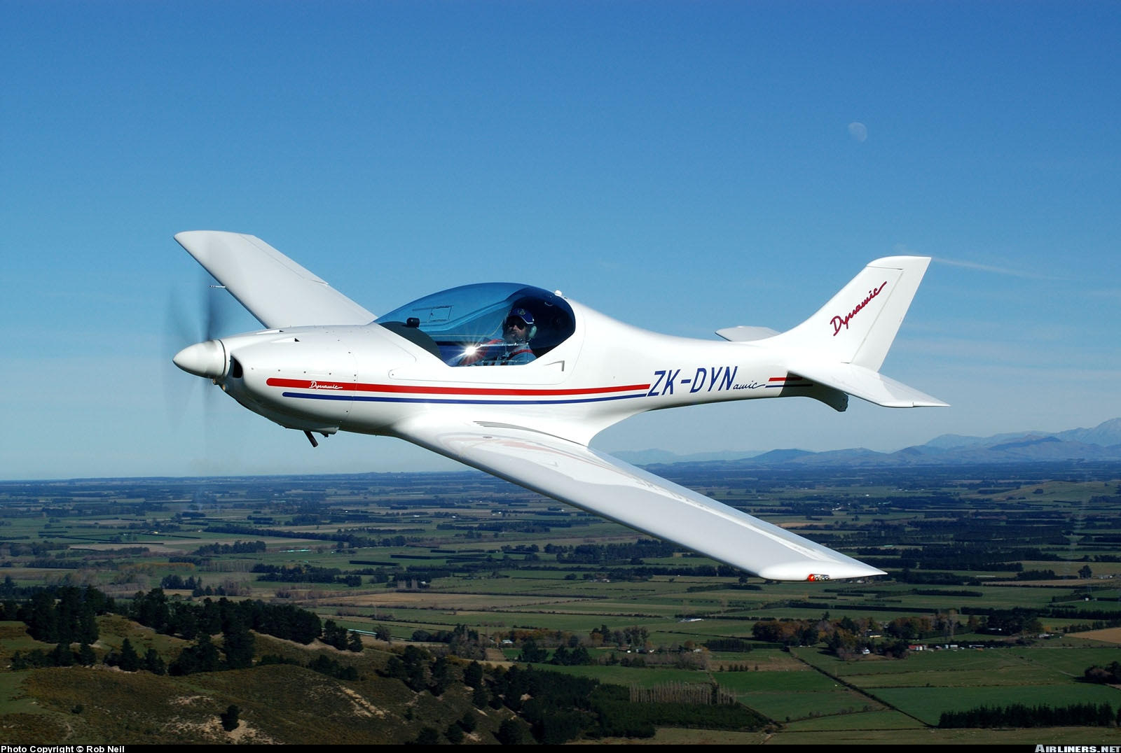

Slide 10
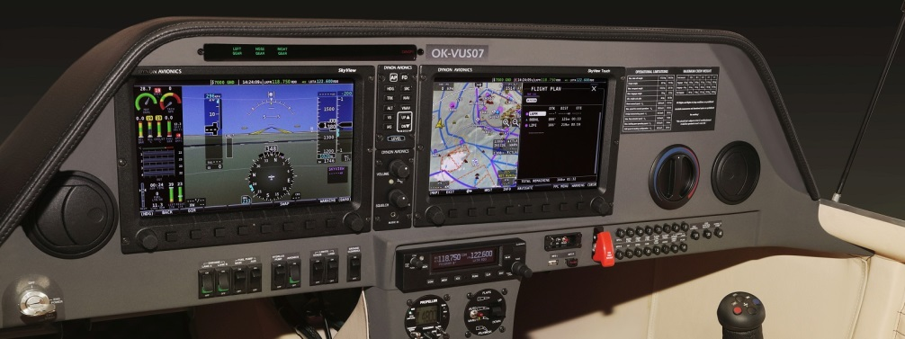
Dynon Skyview – Microlight.

Slide 11
Consistent – across pilot groups.
Microlight – low inertia aircraft - no – Ultralight and ultrafast.
Legacy aircraft, well proven.
Glider pilots, balloon pilots, drone pilots.
Recreation pilots – deemed limited competency – why?
PPL pilots – vast range of accepted competency.

Slide 12
Harmony across the World:
ICAO has a critical role in keeping commercial aviation safe.
Private: Pleasure and Business aviation is important.
Medical Standards are a small contributor to aviation safety.
Many other competencies should be aligned.
IAOPA pilots will be major beneficiaries of international harmonisation.

Slide 13
AOPA NZ
IAOPA works with ICAO to develop a more appropriate PPL Medical Standard.
CAA RPL is changed to use a DL9 car licence medical standard and the ‘privileges’ are extended to those of PPL.

